Slide 1

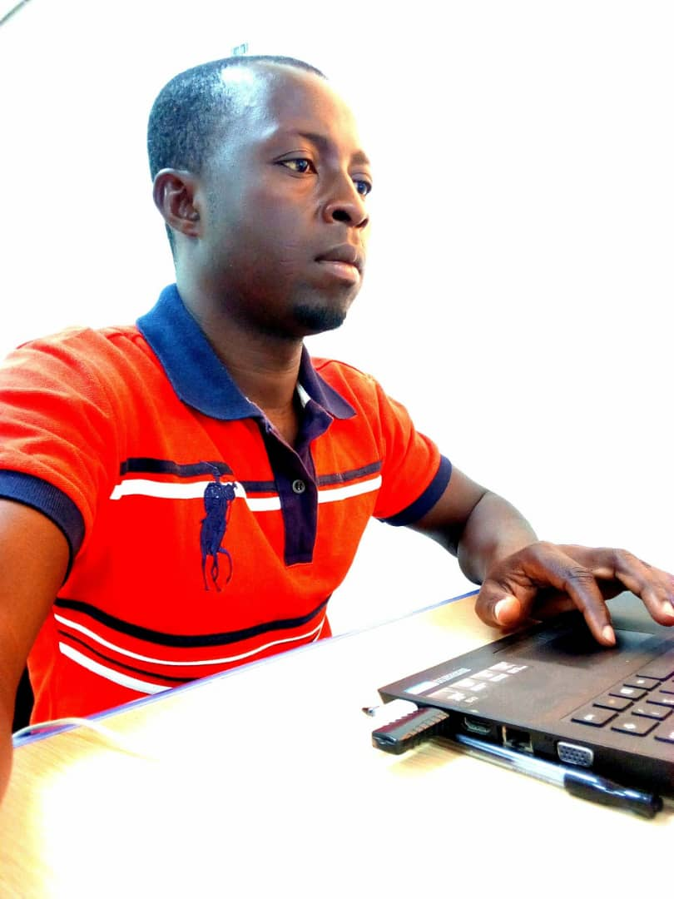
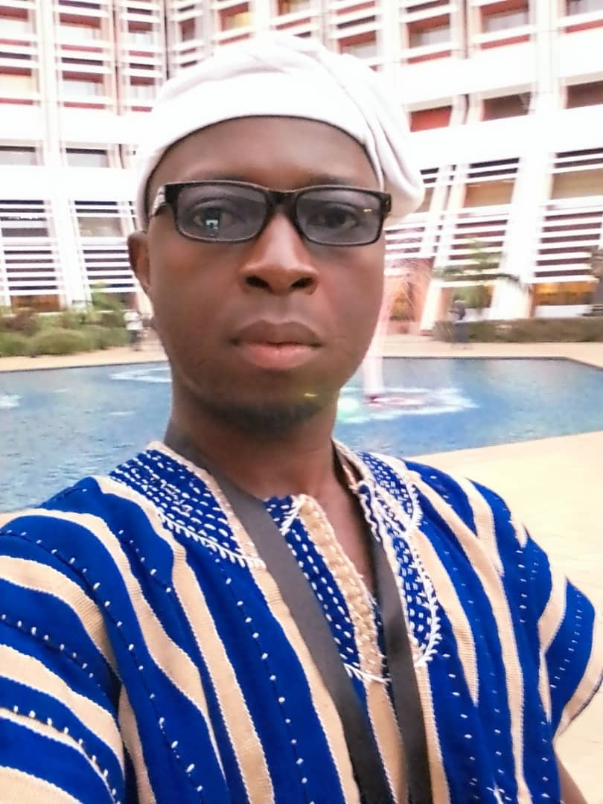
Science Journey
Biigba Yakubu
KNUST
+233557136295
The study of science must be driven by passing and fulfilment with money being a positive externality
This is my science journey

Slide 2
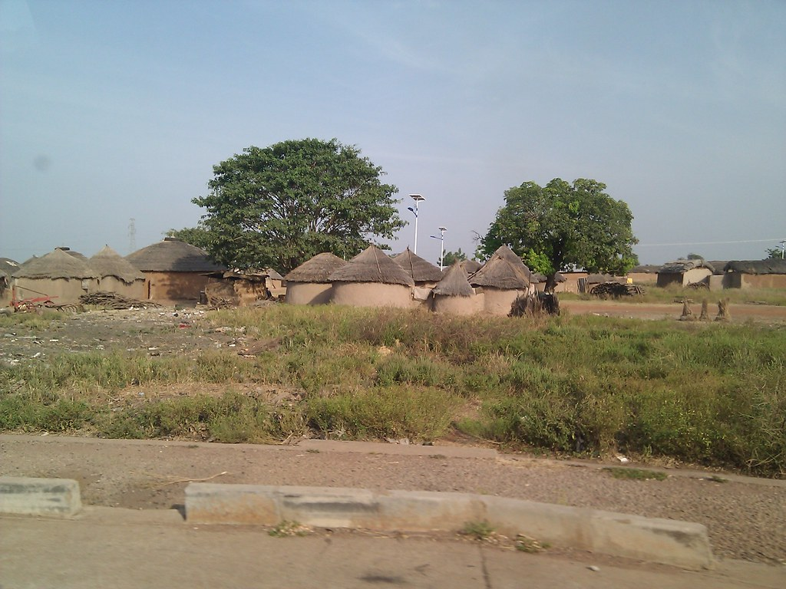
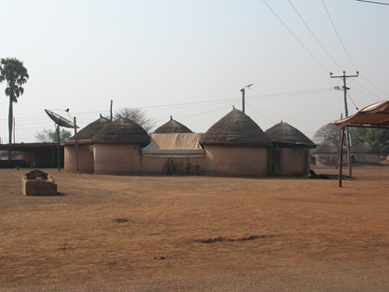
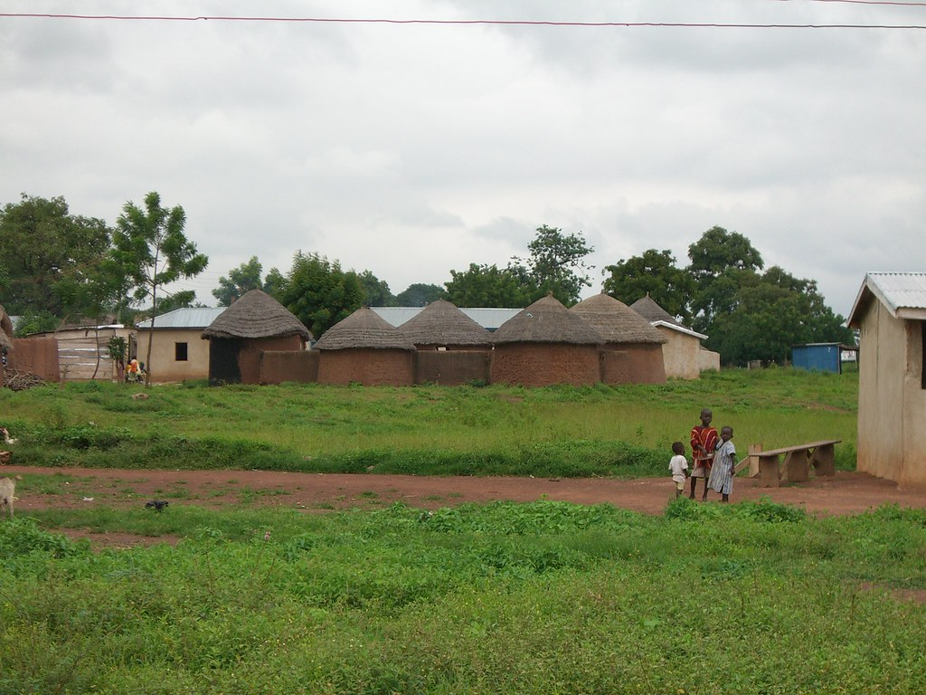
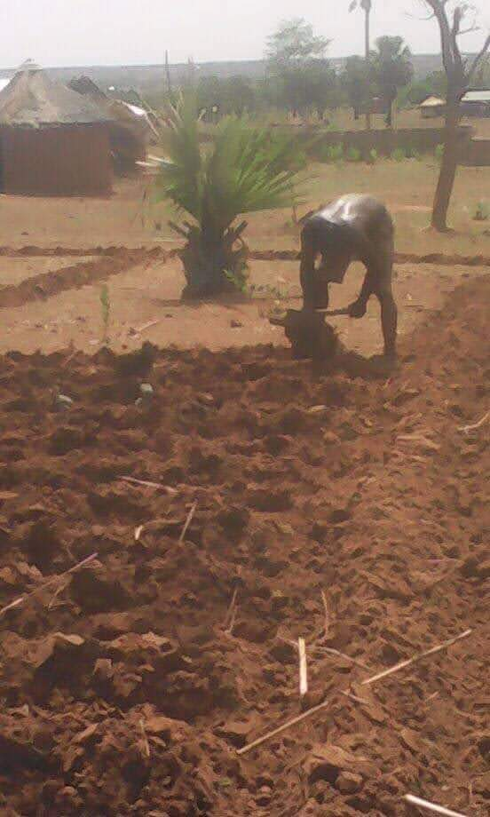
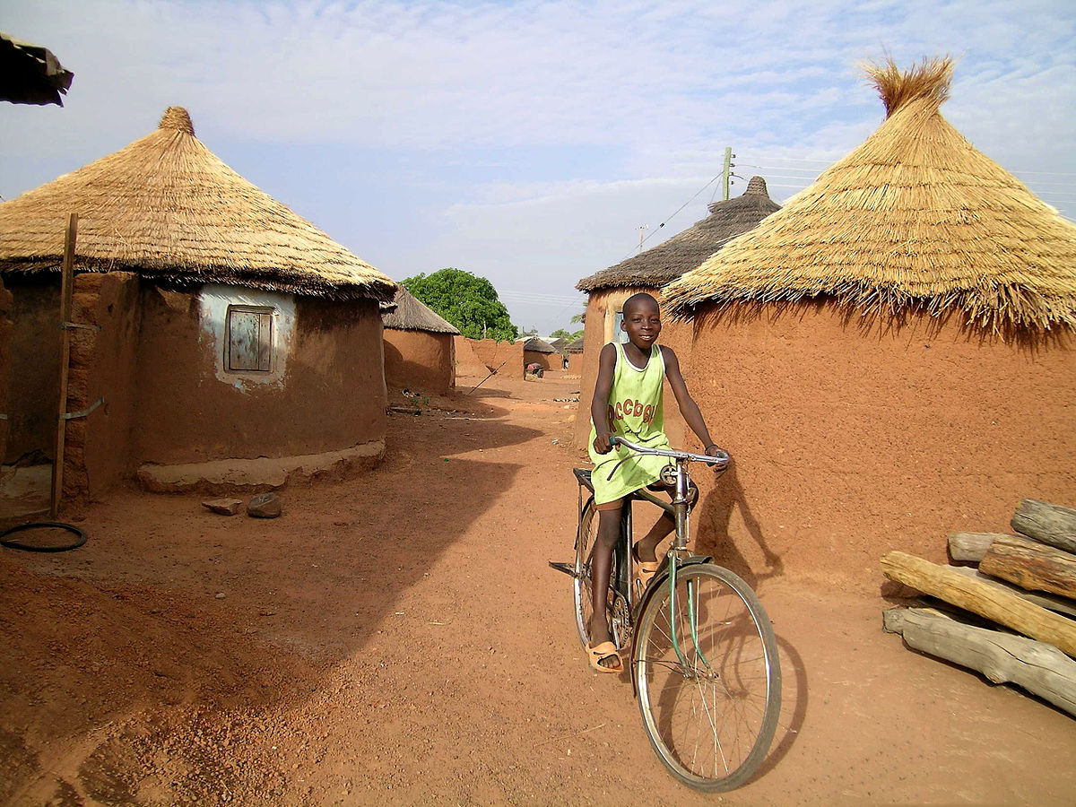
From My Home Region, Najong No2, North East Region, Ghana
Home village then Village now
Village Schooling
The struggles to educate oneself (ploughing manually for money)
The journey sometimes on Bicycle (little comfort)

Slide 3
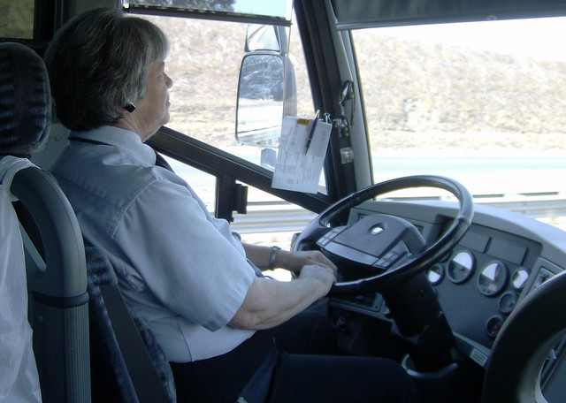

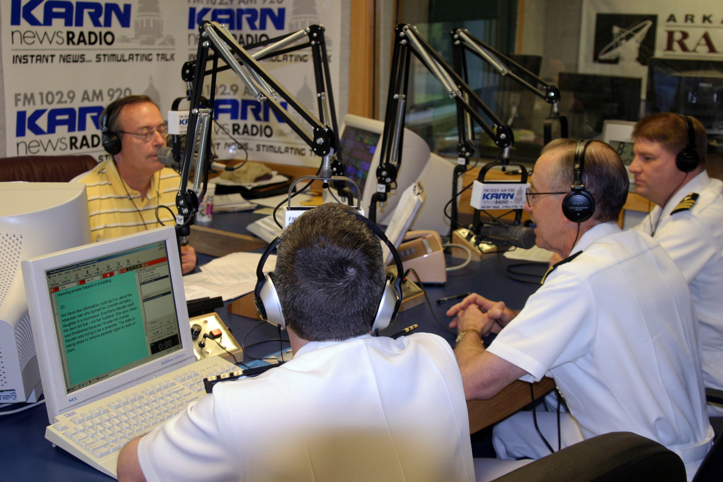
Childhood Ambitions
These curiosities made me asked very scientific questions and shaped my thinking faculties unknowingly…………………today I see the sense through my science education
Bus driver
Architecture
A media person
How can you sit in Nairobi yet people in Mombasa hear you?
Wanted to know how the wheels rotate
how possible it is to pack blocks up to that height without it falling?

Slide 4
What is science Education about?
Is about curiosity, factual proves and fulfilment, and not for money making

Slide 5
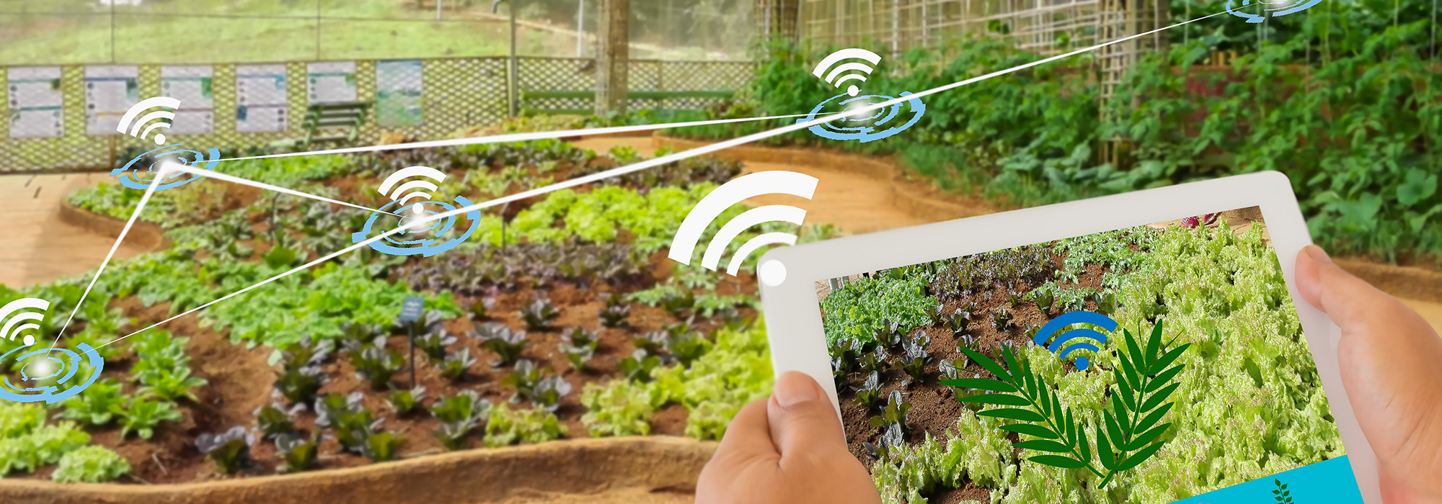

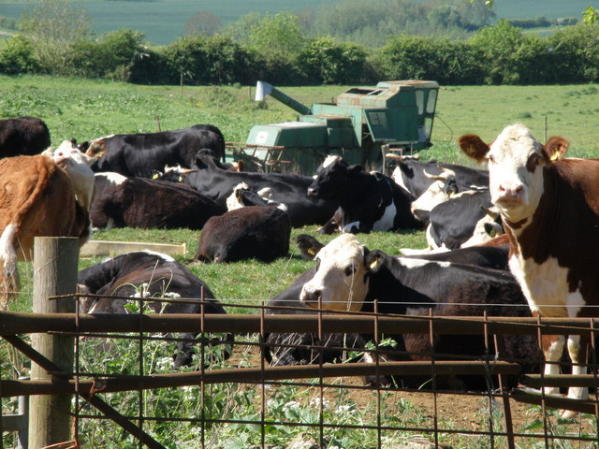

The Trajectory Started
High School Education
College Education
Studied Agricultural science including chemistry, physics and elective mathematics. Then studied biology personally, wrote the exams and passed
Bagabaga college of Education; I studied science and pre-technical skills, majored in the teaching of science, mathematics, ICT and the pre-technical skills

Slide 6
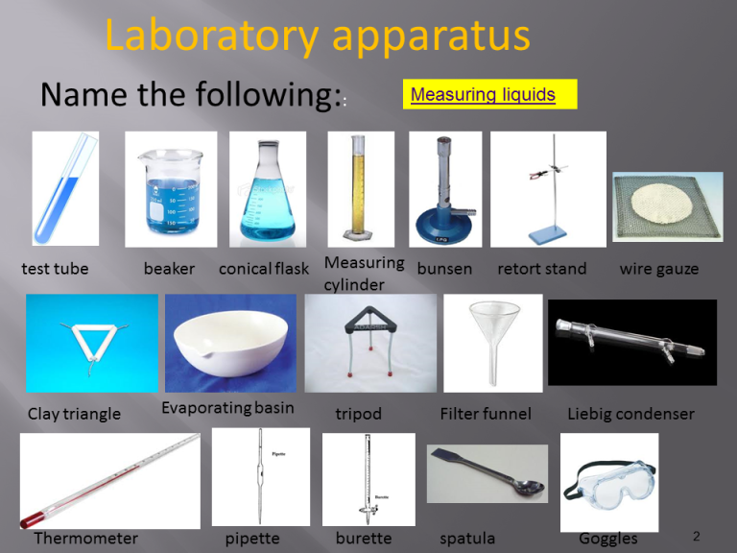


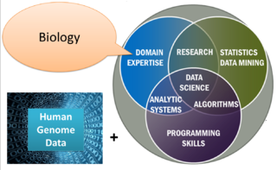
First Job
Taught the following subject in High school
Science ICT Mathematics
Perhaps the drive to be in bioinformatics started here unknowingly as all that is required in Bioinformatics is summarized here

Slide 7

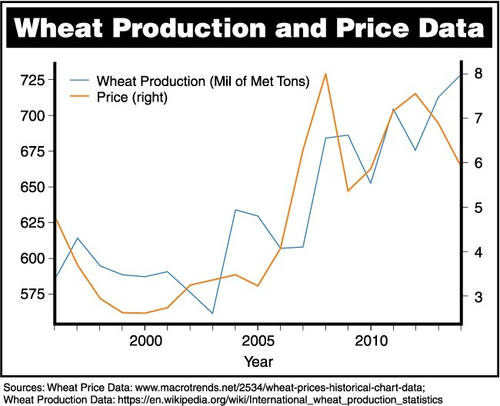


University Education, KNUST
B.Sc Agricultural economics
Globalization
Studied Globalization on personal basis because I was jobless and decided to use the period to sharpen my economics skills so I could contribute to national economic discourse

Slide 8


Second Job (Private Sector)
Worked wit united states Agency on International Development, on the program; Resiliency in Northern Ghana, RING under the project, community led Total sanitation as a CONSULTANT

Slide 9
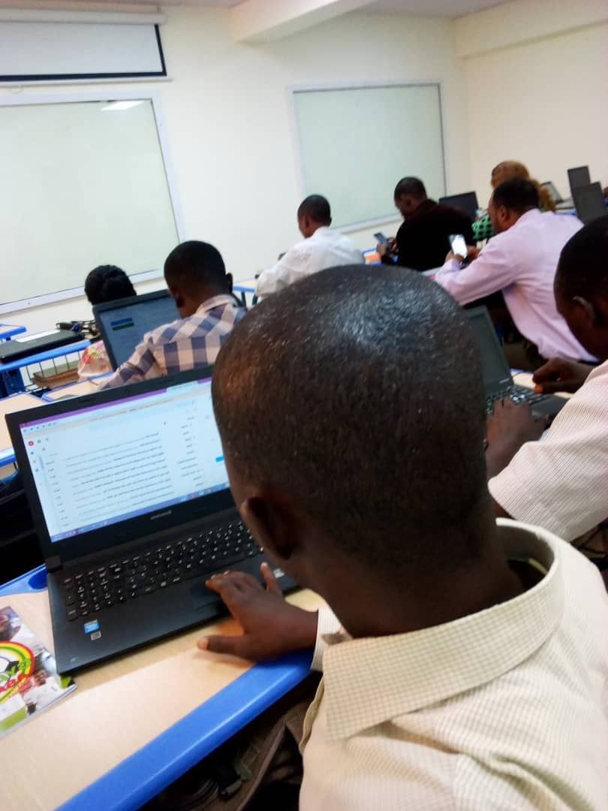
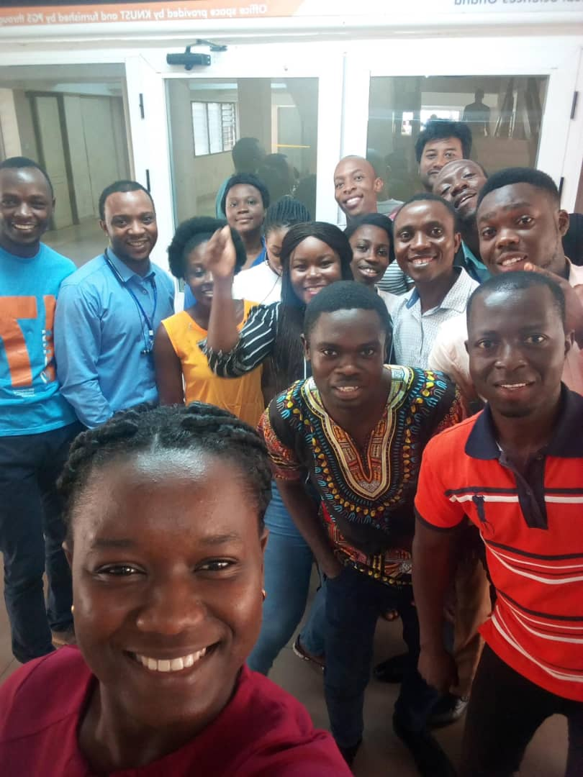
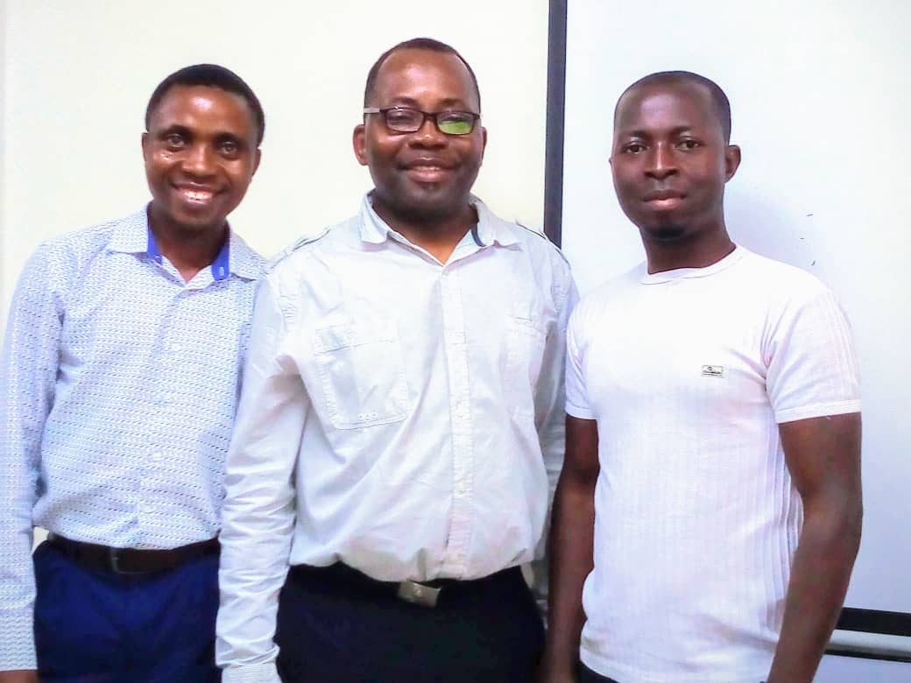
2nd West African sustainable leadership innovative training in bioinformatics Research, WASLITBRe workshop, KNUST, GHANA
I attended the WASLITBRe workshop in 2019 which was on the team
“linking Genomic science to diseases”
During the workshop
Other attendees
Prof. Brew, facilitator(m)

Slide 10


Masters of Philosophy, MPhil
After the WASLIBRE workshop the interest in genomic science and bioinformatics arouse
Thinking Genomics
Thinking Bioinformatics

Slide 11
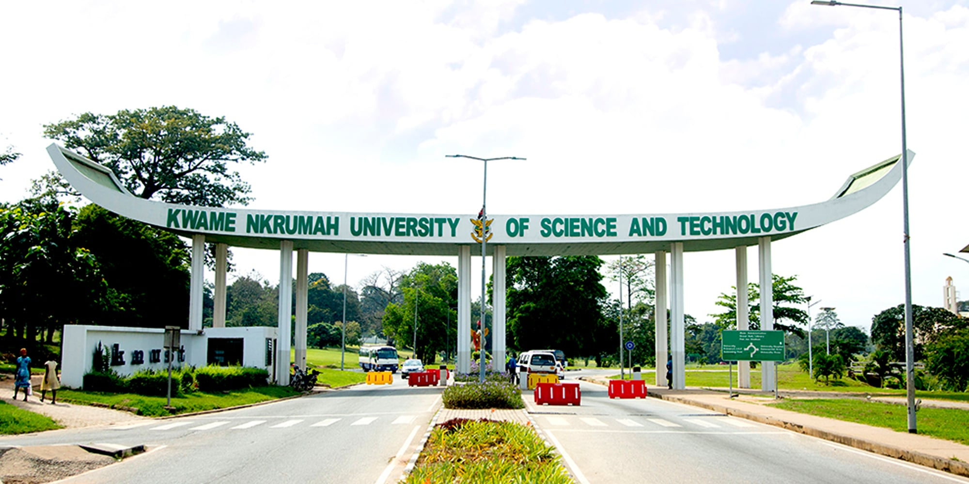
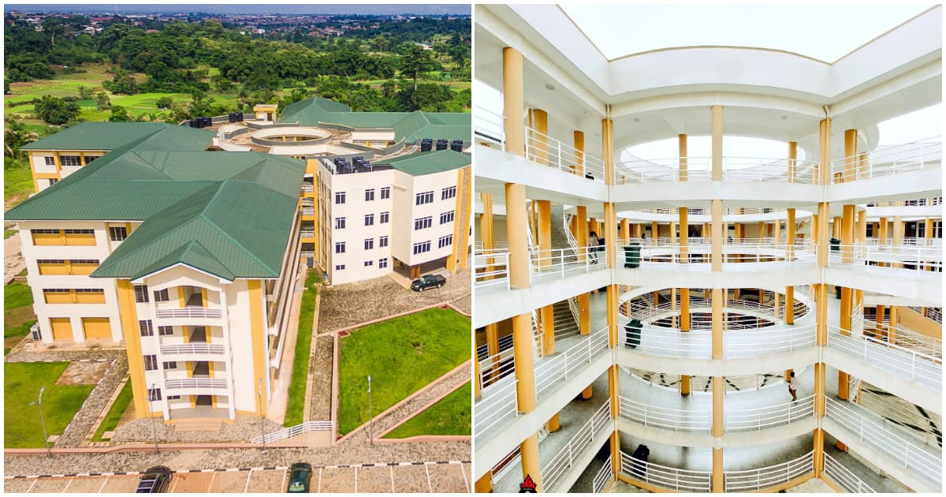
In 2019 I got admission to pursue…………..
Mphil Biodata Analytics and computational Genomics alongside professional training in Bioinformatics intermediary and introduction to Bioinformatics. Also enrolled in Bioinformatics accreditation program.
@ Kwame Nkrumah University of Science and Technology, KNUST
College of Science

Slide 12
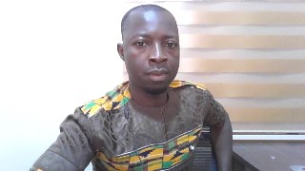
3RD WASLITBRe TAC MEETING 11/04/2022
PRESENTATION ON
Comparative Genomic Analyses of Helicobacter Pylori Isolates Among Patients Using Whole Genome Sequences
BIIGBA YAKUBU
(Biodata Analytics and Computational Genomics)
KNUST, KUMASI, GHANA

Slide 13
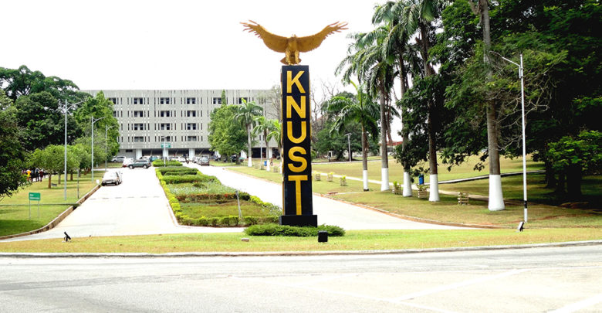
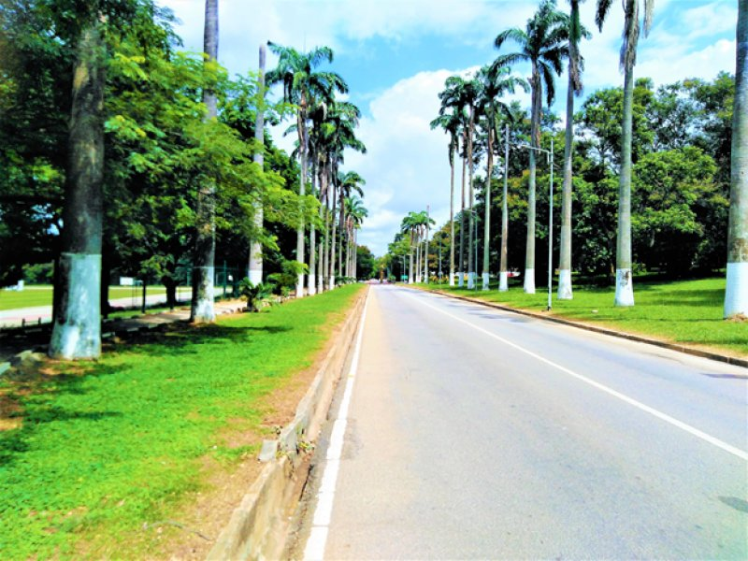
In 2021/2022 Academic year, I got admission to continue with
PhD Biodata Analytics and computational Genomics @
Highway to

Slide 14
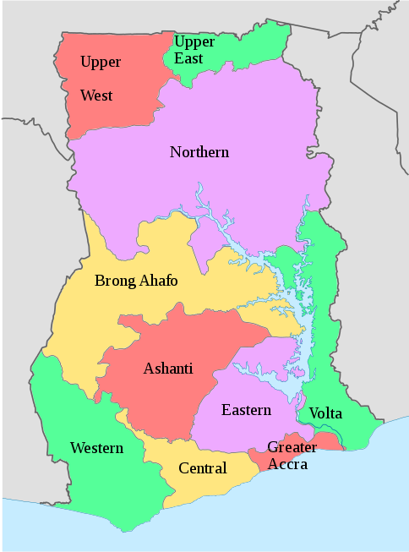

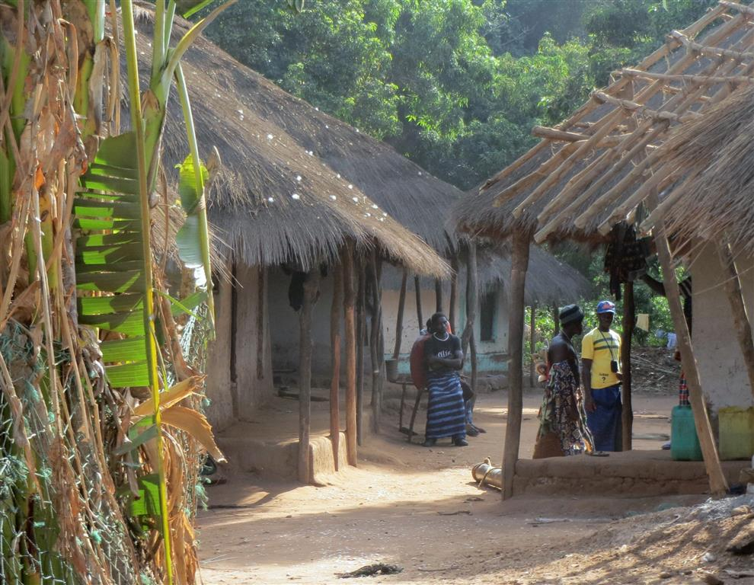
PhD Focal Area
Northern, Upper west, Upper east, North East, Savana
.
Ghanaian GUR people
Figure 4
Bono, Bono East, Ahafo
Ghanaian KWA people
Ashanti, Eastern, Western,western north Central, Greater Accra, volta Oti
Figure 2
Figure 3

Slide 15


Biogeographical Ancestries of Ghanaian GUR People
.
Biigba Bright Y
KNUST, Kumasi

Slide 16



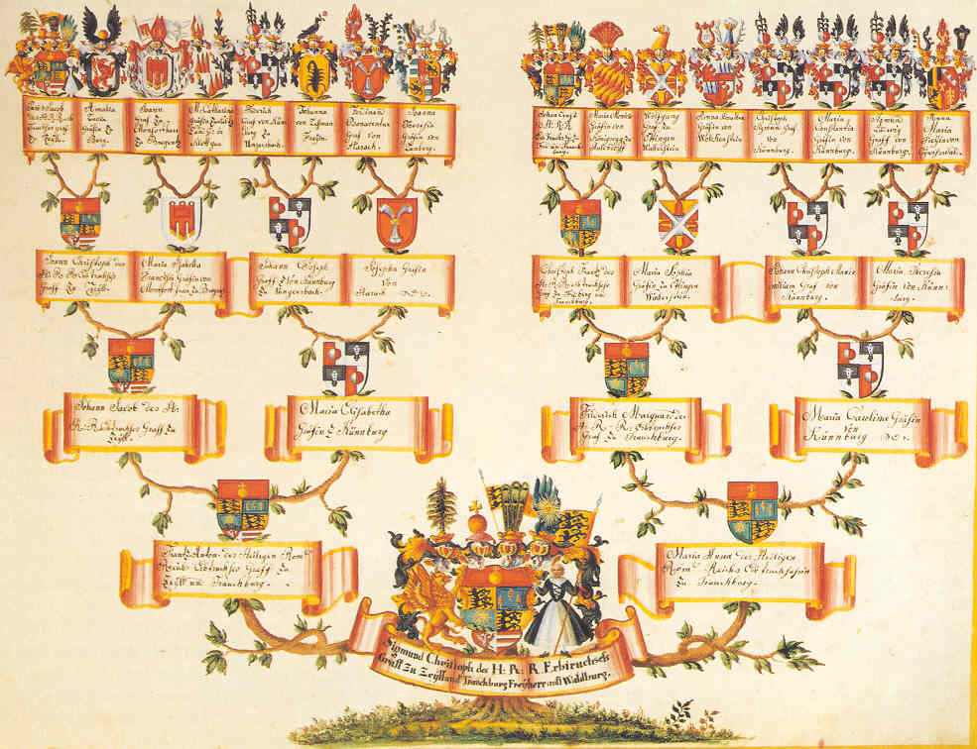
Summary of Science Education Journey
Education Economics Comparative Genomics Biogeographical Ancestry
Diploma in Education
Bachelors of Science
MPhil
PhD

Slide 17

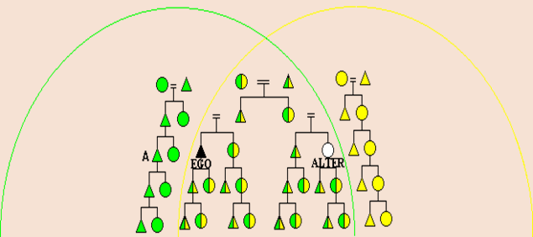
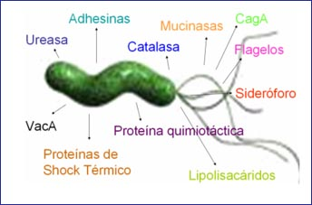
Academics Triangle
Disparities in resource acquisition and the impact on tomato productivity
Biogeographical Ancestries of Ghanaian GUR People and Their Risk of Developing Hypertension
Comparative genomics of Helicobacter pylori
B.Sc
PhD
Mphil

Slide 18
Research Works Involved in
How to stimulate Kids interest in Pre-technical skills Education
Disparities In Resource Acquisition And The Impact On Tomato Productivity
Positive Practices For Improving Child Survival
Eliminating Malnutrition Using Community Led Total Sanitation
Microbiome (16s DADA2)
Cerebrospinal Meningitis
Comparative Genomics of Helicobacter pylori
Biogeographical Ancestries of Ghanaian GUR People and Their Risk of Developing Hypertension

Slide 19




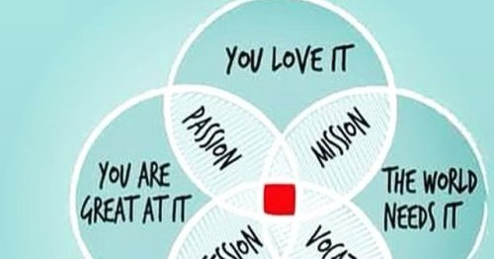
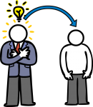

Tenets of Learning Science
The readiness to learn a lot over a short period
.
Sacrifice (give up some luxuries and pleasures and make time to study)
Asking the foolish questions (never shy asking those questions which make you look too mundane)
Never think all you know is all you need to make it (tap from others)
Knowledge transfer. (Chart interpretation in economics can give a leeway to interpreting bioinformatics charts)
The passion to learn (develop passion for learning)
Readiness to be versatile

Slide 20
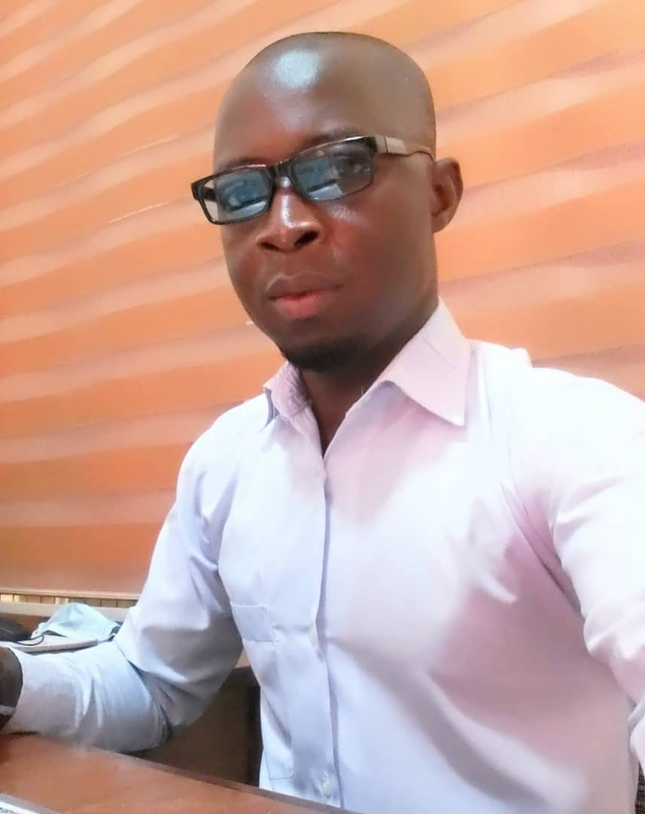
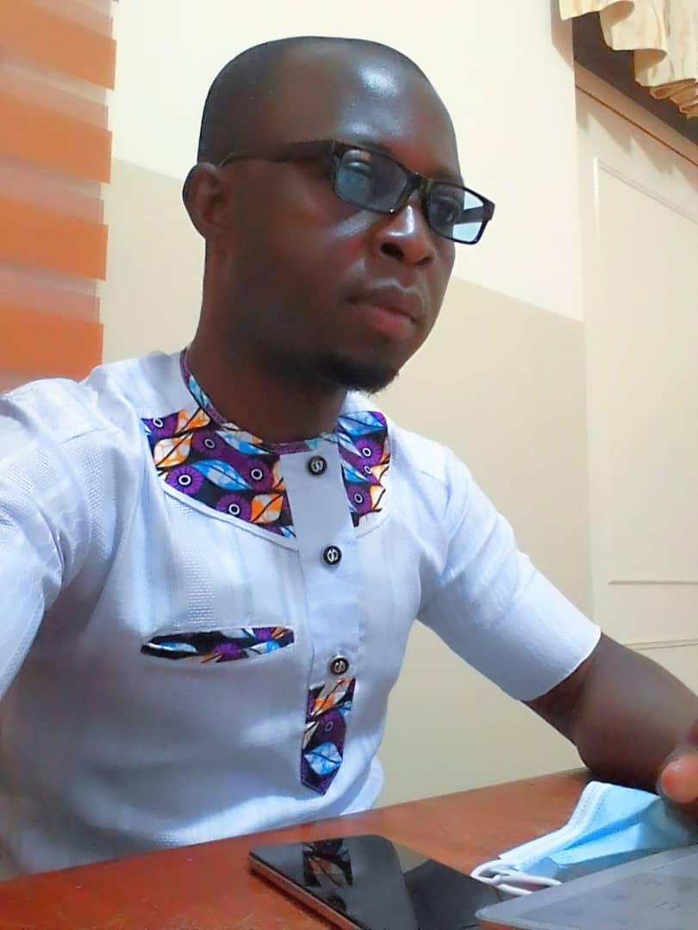
This is so far the start of my science Journey
…
Biigba Bright Yakubu
PhD Biodata Analytics and computational Genomics
.
@

Slide 21
Thank You, Merci

Slide 22



ACKNOWLEDGEMENT
ALL THOSE WHO SUPPORTED THE PROJECT

